Slide 1




State management with NgRx

Slide 2
Overview
What is it?
How do all parts of NgRx fit together?
Why use it?
Why not use it?
Why do we use it?
Resources
Summary
Credits

Slide 3
NgRx - What is it?
NgRx is a reactive state management framework
Reactive change-based flow: either cause change or expect change
State management entity data, loading indicator visible, active route

Slide 4
NgRx - What is it?
Store
{
activeRoute: "/items",
filters: {
"propA": "valA"
},
items: [
{ "name": "item1", "propA": "valA" },
{ "name": "item2", "propA": "valA" }
],
loading: false
}
Actions log
[Route] Navigate payload: { "route": "/items" }
[Filters] Apply payload: { "propA": "valA" }
[Items] Load payload: { "propA": "valA" }
[Items] Load Success payload: { "items": [...] }

Slide 5
NgRx - What is it?
Store before “[Filters] Apply”
{
activeRoute: "/items",
filters: {},
items: [
{ "name": "item1", "propA": "valA" },
{ "name": "item2", "propA": "valA" },
{ "name": "item3", "propA": "valB" },
{ "name": "item4", "propA": "valC" },
{ "name": "item5", "propA": "valD" },
],
loading: false
}
Actions log
[Route] Navigate payload: { "route": "/items" }
[Filters] Apply payload: { "propA": "valA" }
[Items] Load payload: { "propA": "valA" }
[Items] Load Success payload: { "items": [...] }

Slide 6
NgRx - What is it?
Store after “[Items] Load”
{
activeRoute: "/items",
filters: {
propA: "valA"
},
items: [
{ "name": "item1", "propA": "valA" },
{ "name": "item2", "propA": "valA" },
{ "name": "item3", "propA": "valB" },
{ "name": "item4", "propA": "valC" },
{ "name": "item5", "propA": "valD" },
],
loading: true
}
Actions log
[Route] Navigate payload: { "route": "/items" }
[Filters] Apply payload: { "propA": "valA" }
[Items] Load payload: { "propA": "valA" }
[Items] Load Success payload: { "items": [...] }

Slide 7
NgRx - What is it? - Redux
An open source JavaScript library to manage application state
Created by Dan Abramov and Andrew Clark
The initial release was in 2015
It is licensed under MIT
Abramov began writing the first Redux implementation, while preparing for a conference talk at React Europe on hot reloading
The three principles
Single source of truth
State is read-only
Changes are made with pure functions

Slide 8
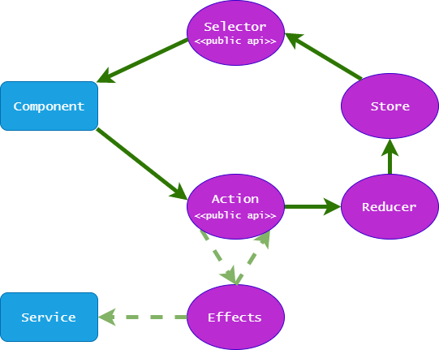
NgRx - How do all parts of NgRx fit together?

Slide 9
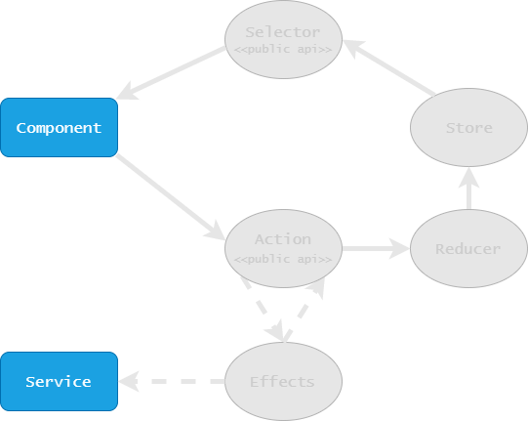
NgRx - How do all parts fit together? - Example 0/10
Store
{
items: [],
loading: false
}
Actions
UI
Flow description

Slide 10
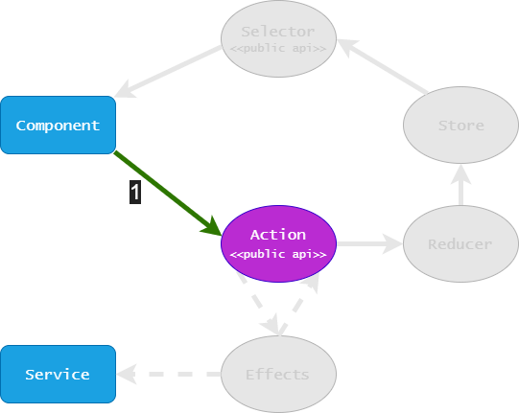
NgRx - How do all parts fit together? - Example 1/10
Store
{
items: [],
loading: false
}
Actions
- [Users] Load
UI
Flow description
1 the component dispatches a “[Users] Load” action

Slide 11
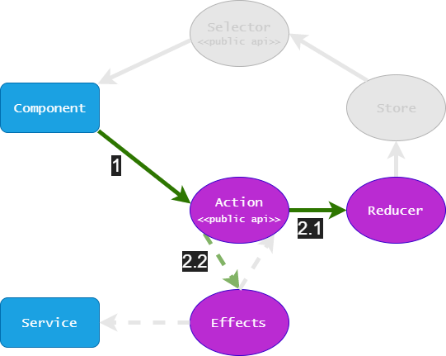
NgRx - How do all parts fit together? - Example 2/10
Store
{
items: [],
loading: false
}
Actions
- [Users] Load
UI
Flow description
2.1 the reducer receives the “[Users] Load” action
2.2 the effect receives the “[Users] Load” action

Slide 12
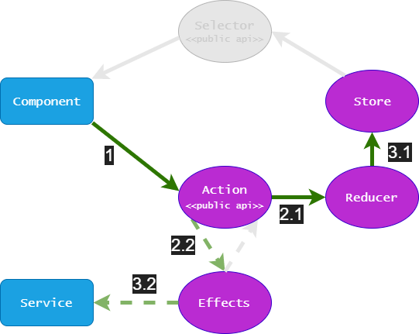
NgRx - How do all parts fit together? - Example 3/10
Store
{
items: [],
loading: true
}
Actions
- [Users] Load
UI
Flow description
3.1 the reducer interprets the action and updates the state accordingly
3.2 the effect interprets the action and requests the users from the API through a service

Slide 13
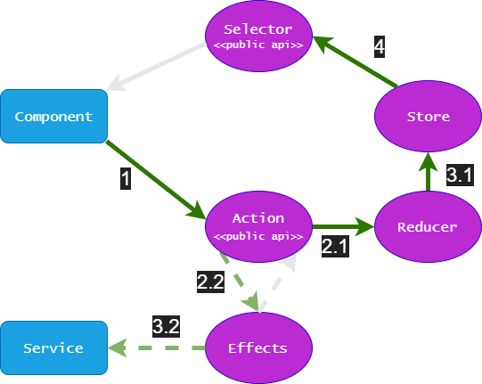
NgRx - How do all parts fit together? - Example 4/10
Store
{
items: [],
loading: true
}
Actions
- [Users] Load
UI
Flow description
4 the store triggers the “loading” selector

Slide 14
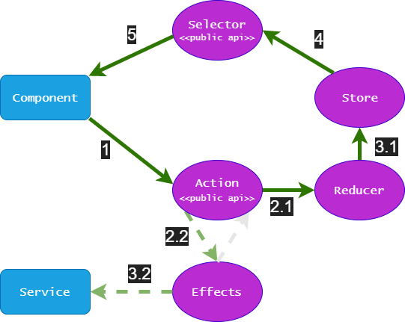
NgRx - How do all parts fit together? - Example 5/10
Store
{
items: [],
loading: true
}
Actions
- [Users] Load
UI
Flow description
5 the “loading” selector notifies the component and the component displays a loading indicator since “loading” is true

Slide 15
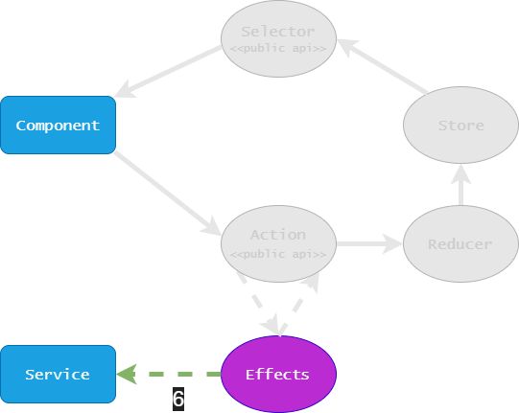
NgRx - How do all parts fit together? - Example 6/10
Store
{
items: [],
loading: true
}
Actions
- [Users] Load
UI
Flow description
6 the service returns the API response

Slide 16
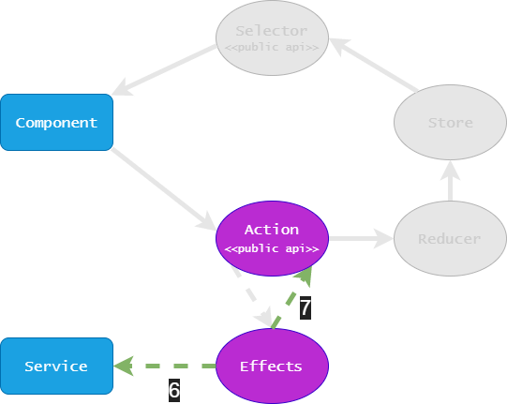
NgRx - How do all parts fit together? - Example 7/10
Store
{
items: [],
loading: true
}
Actions
- [Users] Load
- [Users] Load Success
{
payload: [
{ id: 1, name: "a" },
{ id: 2, name: "b" },
]
}
UI
Flow description
7 the effect dispatches a “[Users] Load Success” action that contains the users list returned by the API

Slide 17
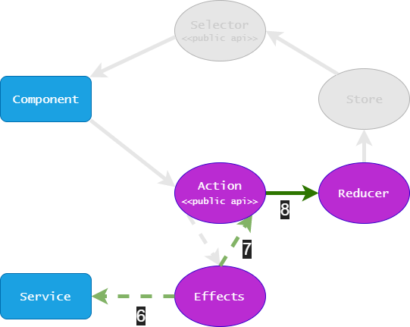
NgRx - How do all parts fit together? - Example 8/10
Store
{
items: [],
loading: true
}
Actions
- [Users] Load
- [Users] Load Success
{
payload: [
{ id: 1, name: "a" },
{ id: 2, name: "b" },
]
}
UI
Flow description
8 the reducer receives the “[Users] Load Success” action

Slide 18
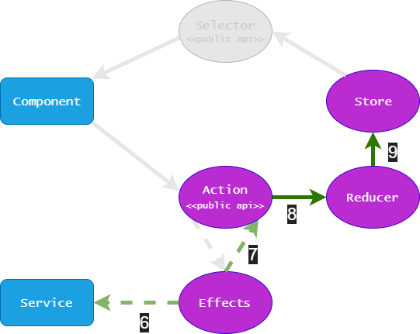
NgRx - How do all parts fit together? - Example 9/10
Store
{
items: [
{ id: 1, name: "a" },
{ id: 2, name: "b" },
],
loading: false
}
Actions
- [Users] Load
- [Users] Load Success
{
payload: [
{ id: 1, name: "a" },
{ id: 2, name: "b" },
]
}
UI
Flow description
9 the reducer interprets the “[Users] Load Success” action and updates the state accordingly

Slide 19
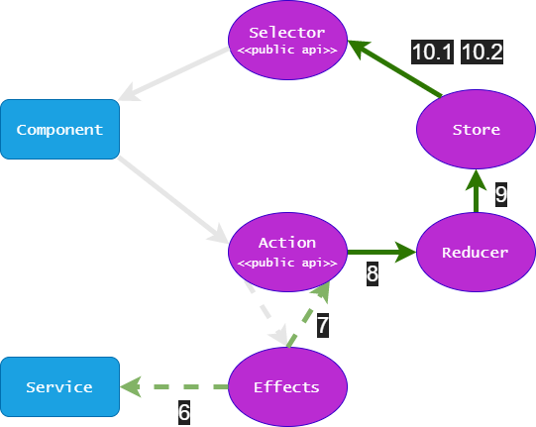
NgRx - How do all parts fit together? - Example 10/10
Store
{
items: [
{ id: 1, name: "a" },
{ id: 2, name: "b" },
],
loading: false
}
Actions
- [Users] Load
- [Users] Load Success
{
payload: [
{ id: 1, name: "a" },
{ id: 2, name: "b" },
]
}
UI
Flow description
10.1 the store triggers the “users” selector
10.2 the store triggers the “loading” selector

Slide 20
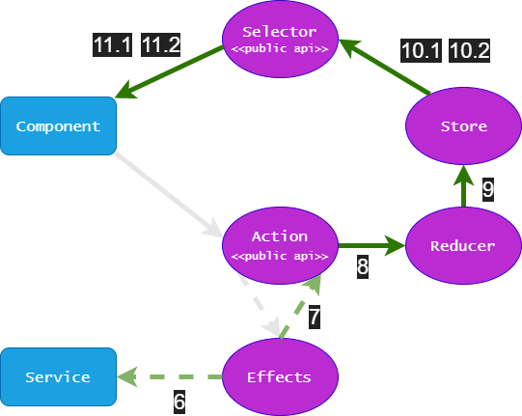
NgRx - How do all parts fit together? - Example 10/10
Store
{
items: [
{ id: 1, name: "a" },
{ id: 2, name: "b" },
],
loading: false
}
Actions
- [Users] Load
- [Users] Load Success
{
payload: [
{ id: 1, name: "a" },
{ id: 2, name: "b" },
]
}
UI
Flow description
11.1 the “items” selector notifies the component and the component displays the users list
11.2 the “loading” selector notifies the component and the component hides the loading indicator
id | name
1 | a
2 | b

Slide 21
NgRx - Why use it? - Predictability
Structured changes only actions cause state changes, only reducers update state, only selectors read state, only effects handle side-effects
No update race conditions actions served in dispatch order
Unidirectional flow

Slide 22
NgRx - Why use it? - Maintainability
Single source of truth
Cleaner code separation of concerns
Debugging tools (store-devtools) actions trail, state diffs, time travel
Unit testing tools provideMockStore, provideMockActions, selector projector()
Declarative style

Slide 23
NgRx - Why use it? - Performance
Immutability + Angular OnPush minimize redraws
Selector memoization and rendered models country flag, is action available
Shared data among components

Slide 24
NgRx - Why use it? - SHARI
Shared state that is accessed by many components and services
Hydrated state that is persisted and rehydrated from external storage
Available state that needs to be available when re-entering routes
Retrieved state that must be retrieved with a side-effect
Impacted state that is impacted by actions from other sources

Slide 25
NgRx - Why not use it?
Framework complexity a lot of steps for setup, boilerplate code
RxJS prior knowledge is not required, but lack of can contribute to slower integration
Need fully object-oriented solution selectors and reducers promote a functional paradigm

Slide 26
NgRx - Why do we use it?
Technology Angular
Data sharing multiple components need same piece of data
Effects encapsulation of external interactions and business logic
Testable

Slide 27
Resources
NgRx ngrx.io
Redux redux.js.org
Redux DevTools extension.remotedev.io
Flux facebook.github.io/flux
ReactiveX reactivex.io
RxJS rxjs-dev.firebaseapp.com
CQRS martinfowler.com/bliki/CQRS.html, docs.microsoft.com/en-us/azure/architecture/patterns/cqrs
Event sourcing martinfowler.com/eaaDev/EventSourcing.html, docs.microsoft.com/en-us/azure/architecture/patterns/event-sourcing

Slide 28
NgRx - Summary
A state management framework
Predictable
Provides clear separation of concerns leads to cleaner application code
Integrates easily with Angular’s OnPush strategy
Testable

Slide 29
NgRx - Credits
Credits to my very good friend and colleague Stratos Vetsos for his help on store setup and great usage insights during our .

